Slide 1
Algorithms and tools for preserving privacy
Julia Ive

Slide 2
Session Outline
Types of privacy
Privacy risks
Privacy Preservation for Text
Methods of privacy protection
Pre-processing
ML Methods
Key Takeaways
Learning Outcomes
Distinguish types of attacks
Awareness of the privacy protection measures per attack type

Slide 3
Types of Privacy
Individual privacy
Disclosure of information related to an identified or identifiable person (personal data, personally identifiable information, PII)
Group privacy
Disclosure of information about categories or groups (often deduced from personal data)
Data privacy
Protection of the model’s training data
ML models tend to memorise training datasets

Slide 4
Privacy Risks
Singling out - possibility to isolate records which identify an individual in the dataset
Linkability - ability to link records concerning the same data subject (same or different databases)
Attacks on both group and individual privacy
Attacker can establish (e.g., via correlation analysis) records of the same group but cannot single out individuals in this group
https://ec.europa.eu/justice/article-29/documentation/opinion-recommendation/files/2014/wp216_en.pdf

Slide 5
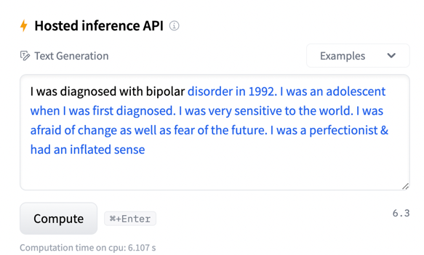
Privacy Risks
Inference - possibility to deduce the value of an attribute from the values of other attributes
Can be identity, protected attributes (e.g., age or gender etc.)
Membership inference attack - given black-box access to a model, determine whether a particular training example was in the training set for that model
https://huggingface.co/EleutherAI/gpt-neo-1.3B

Slide 6
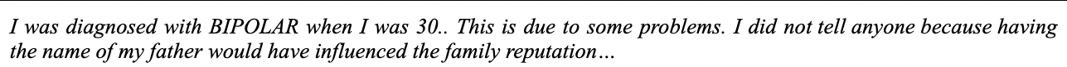
Privacy Preservation for Text
Direct Identifier:
Variable(s) directly identifying an individual (such as name, address, phone number or bank account)
Quasi Identifier:
Information (such as gender, nationality, or city of residence) that alone does not enable re-identification, but may do so when combined with other quasi-identifiers and background knowledge
Author style:
Individual choice of linguistic units and constructions

Slide 7
Privacy Preservation for Text
Pre-processing
Anonymisation is irreversible removal of any information that could lead to an individual being identified
Pseudonymisation is the process of replacing direct identifiers with pseudonyms or coded values (such ”John Doe” → ”Patient 3”)
Mapping between to the original identifiers is then stored separately and can be used for re-identification
Renders data neither anonymous nor directly identifying
Machine Learning Techniques to prevent memorisation
Federated Learning
Differential Privacy
Adversarial Training

Slide 8
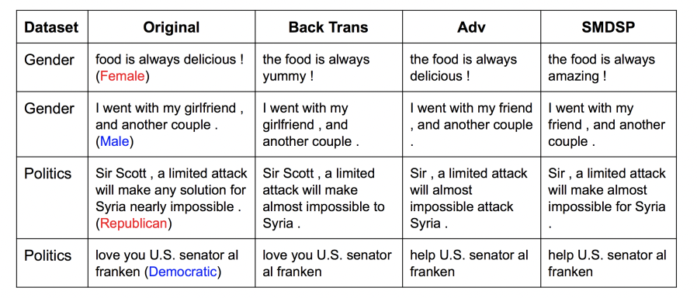
Anonymisation Techniques
De-identification - removing specific, predefined direct identifiers – may disrupt information quality
Randomization techniques alter the veracity of the data
By itself does not protect from singling out
Text re-writing / paraphrasing to obfuscate attributes or author style
No mathematical guarantee of privacy protection
Xu et al. 2018. Privacy-Aware Text Rewriting

Slide 9
Approaches to Anonymisation
Generalization techniques generalise the attributes by modifying their respective scale: e.g., a month rather than a week
Effective to prevent singling out, need to be combined with randomisation to protect against inference attacks/risks

Slide 10
Approaches to Anonymisation
C-sanitisation – obfuscation of identifiable information by means of semantic inference, i.e. replacement with synonyms or homonyms
K-anonymity – property of the data so that an individual contained in it can not be distinguished from at least k-1 individuals whose information also appears in the data
Primarily addresses the linkage risk
Not many methods for text
Usually involve term extraction
Sweeney. 2015. Only You, Your Doctor, and Many Others May Know

Slide 11
ML Methods: Federated Learning
Allows to learn global model weights without access to the local data
Models are learnt locally and are regularly merged into the global model at the next level of aggregation
https://blog.ml.cmu.edu/2019/11/12/federated-learning-challenges-methods-and-future-directions

Slide 12
ML Methods: Differential Privacy
Differential privacy (DP) (Abadi et al., 2016) – state-of-the-art noise injection technique that guarantees the attacker can not learn more about an individual than they would learn if that person’s record were absent from the dataset
DP for model training adds noise to the updates of model weights in such a way that singular training examples can not be inferred from outputs
https://www.nist.gov/blogs/cybersecurity-insights/how-deploy-machine-learning-differential-privacy

Slide 13
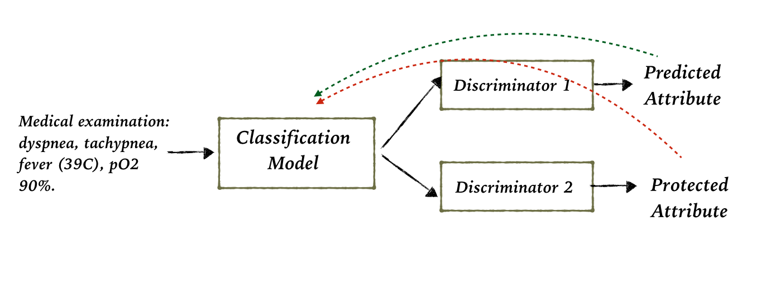
Adversarial Training
Adversarial and Reinforcement Learning (RL) architectures can be learnt to create examples indistinguishable from real examples
In a similar way, they can be used to create examples/representations indistinguishable for some protected attributes (e.g., (Elazar and Goldberg, 2018; Mosallanezhad et al., 2019))

Slide 14
Key Takeaways
Privacy preservation for text is challenging due to its compositional and ambiguous nature: it is difficult to differentiate and disentangle direct and indirect identifiers without disturbing textual structure, also individual privacy can be breached via author style
Privacy preservation methods mostly handle only the protection of direct pre-set identifiers or quasi-identifiers
Indirect identifiers are more difficult to protect
Pre-processing approaches to anonymisation remove identifiers or replace these identifiers with placeholders (e.g., via pseudonymisation or paraphrasing)
Obfuscation of the author's linguistic style can be done via text re-writing
Memorisation can be prevented using the techniques of Federated Learning and overfitting prevention with Differential Privacy

